Slide 1
FIBER DIAMETER
PREDICTION
Kumaresh N M E0320004, Adhithyan B E0320005, Dhrish S Kumar E0320008, Rohit A Ch E0320022

Slide 2
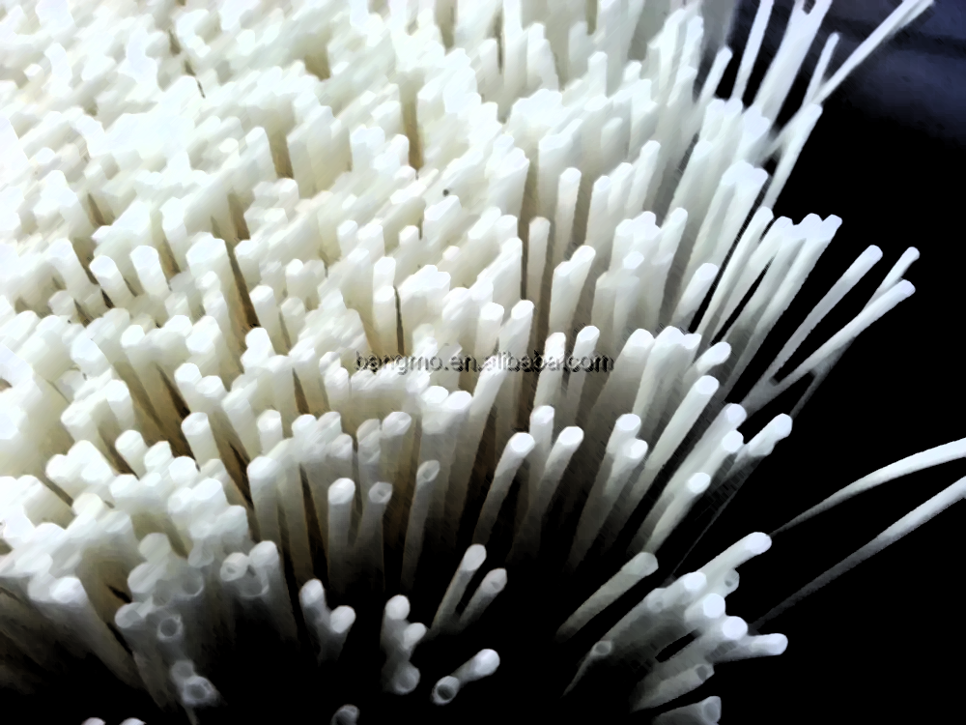
Introduction
Polyvinylidene fluoride (PVDF) is a high-performance thermoplastic polymer that is known for its excellent chemical resistance, thermal stability, and mechanical properties.
They have high tensile strength, good abrasion resistance, and excellent chemical resistance, making them suitable for use in harsh environments.
PVDF fibers are also highly resistant to UV radiation, making them ideal for outdoor applications.
PVDF nanofibers/films are utilized in sensors, batteries, and nanogenerators.

Slide 3
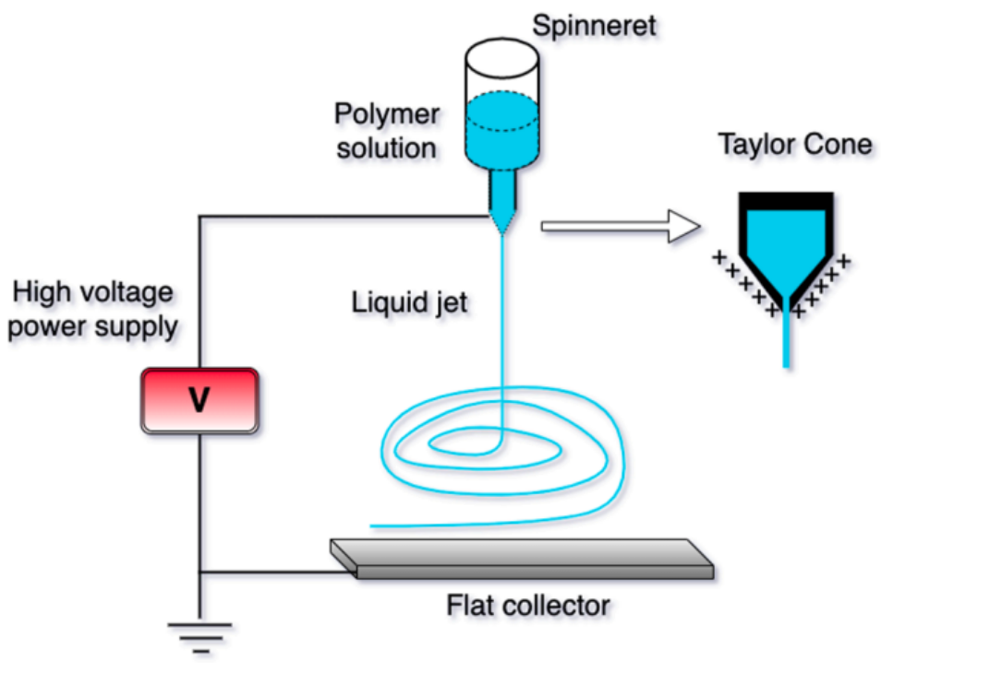
Electrospinning
Various methods have been proposed to create PVDF nanofibers. Electrospinning is a preferred method because of its straightforward process where a liquid droplet is charged to create a jet that is then collected in the form of microfibers or nanofibers. However, despite its simplicity in concept and widespread use, the process is complex and requires a thorough understanding of electrostatics, fluid rheology, and the properties of the polymer solution system to achieve the desired fiber properties. Although around a hundred different polymers have been electrospun, the lack of empirical models and reported experimental data continue to impede the understanding of the process.

Slide 4
Animation of Electrospinning

Slide 5
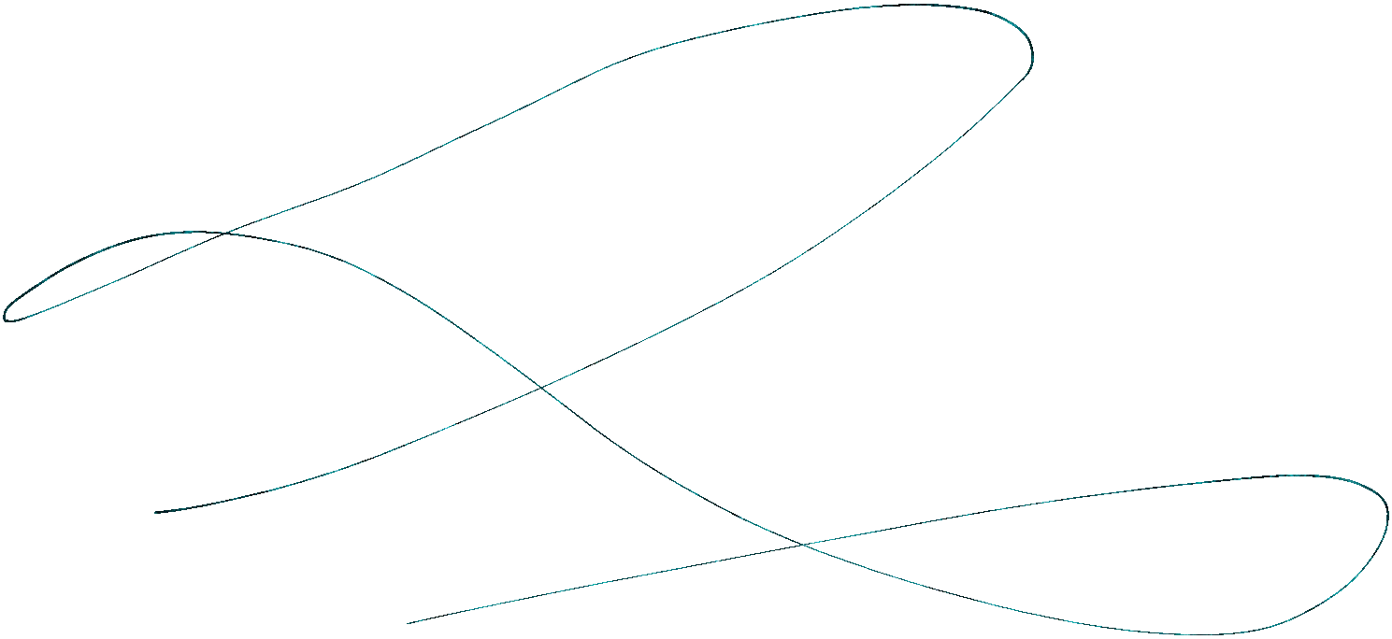
Objective
The objective of fiber diameter prediction using machine learning is to develop a model that can accurately predict the diameter of electrospun fibers based on various input parameters.
These parameters may include solution concentration, solvent type, spinning distance, voltage, and feed rate. By accurately predicting fiber diameter, this model can aid in optimizing the electrospinning process, allowing for the production of fibers with the desired diameter and properties.
It can also help researchers and manufacturers in the field of nanofiber production to design more efficient and effective electrospinning processes, leading to improved product quality, yield, and cost-effectiveness.

Slide 6
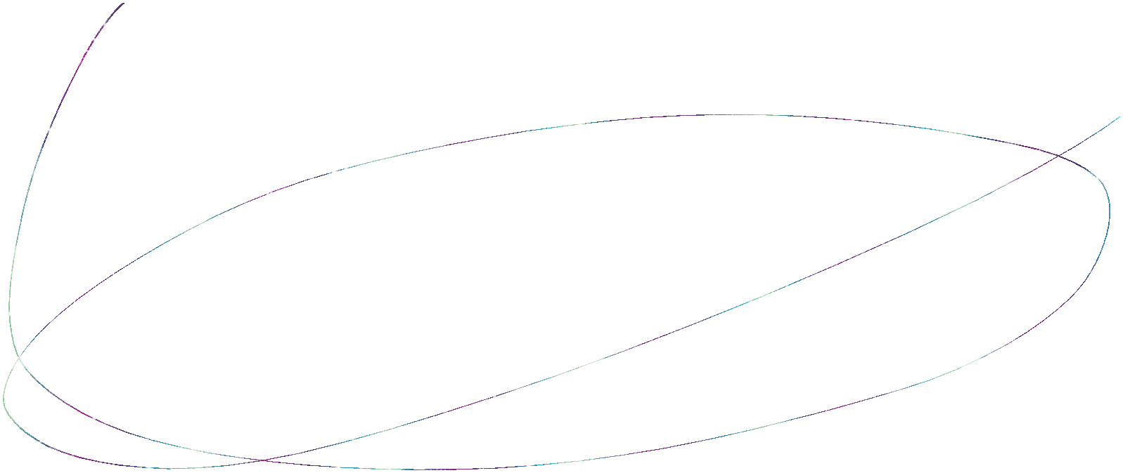
Fiber Experimental Attributes Dataset (FEAD)
The dataset used for fiber diameter prediction using machine learning typically includes samples of electrospun fibers along with the corresponding input parameters such as solution concentration, solvent type, spinning distance, voltage, and feed rate. The dataset may also include other parameters such as relative humidity and temperature.
The diameter of the fibers is the target variable that needs to be predicted. The dataset may consist of both numerical and categorical variables. The dataset may also have missing values or outliers, which must be handled appropriately during data preprocessing.
The size of the dataset may vary, but a larger dataset is generally preferred to improve the accuracy of the machine learning model. Additionally, the dataset should be representative of the range of input parameters used in actual electrospinning processes to ensure that the model's predictions are accurate and reliable.

Slide 7
Methodology
1
2
3
4
DATA PREPROCESSING
MODELING
MODEL DERIVATION
PERFORMANCE
EVALUATION
Linear Regression
Gradient Descent
Decision Tree
Polynomial
Selecting model with optimal parameter set
Root Mean Squared Error
Coefficients of determination
1.Collection 2.Cleaning 3.Analysis

Slide 8
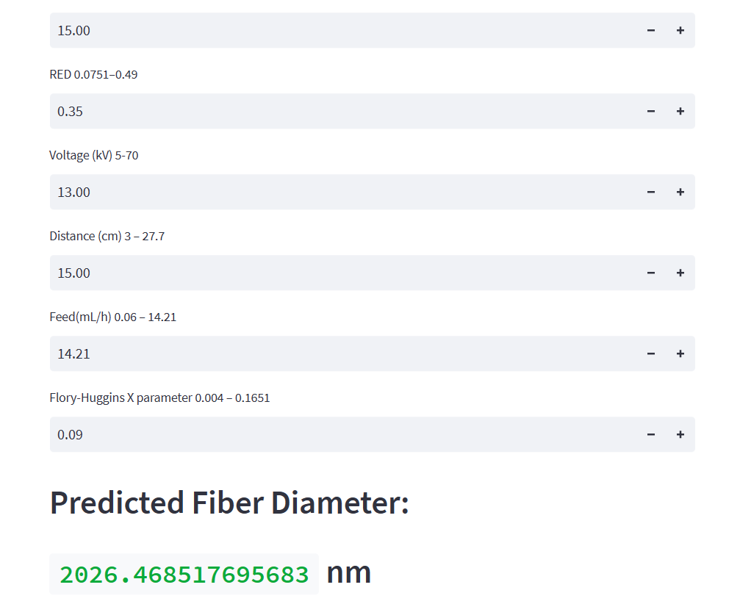
Output

Slide 9
Conclusion
The development of an interpretable machine learning model for electrospun PVDF fiber properties can provide valuable insights into the relationships between input parameters and fiber properties, aiding in the optimization of the electrospinning process.
The model can also help to identify critical input parameters that affect fiber properties, allowing for more targeted experimentation to improve the quality of the fibers.

Slide 10
Thank you

